Slide 1

DATA ANALYST INTERNSHIP
TASK 3: DIABETES PREDICATION ANALYSIS
By
Aashish Raj

Slide 2
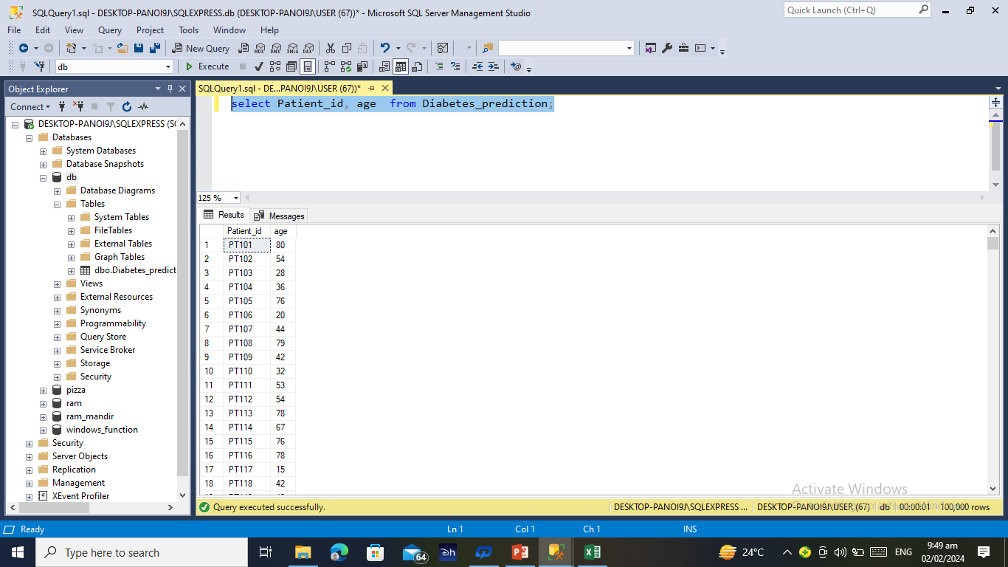
Q1. Retrieve the Patient_id and ages of all patients.

Slide 3
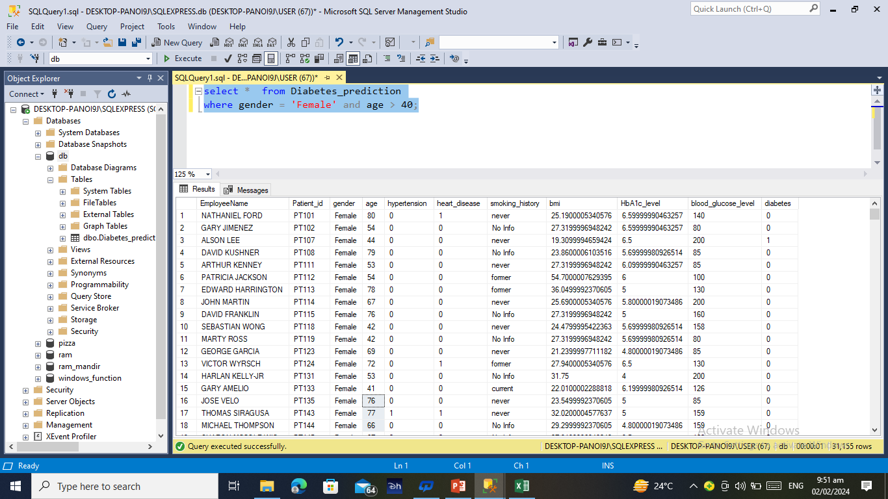
Q2. Select all female patients who are older than 40.

Slide 4
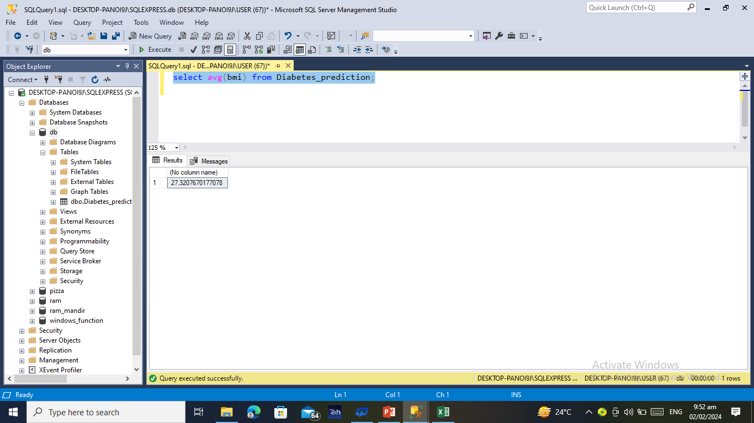
Q3. Calculate the average BMI of patients.

Slide 5
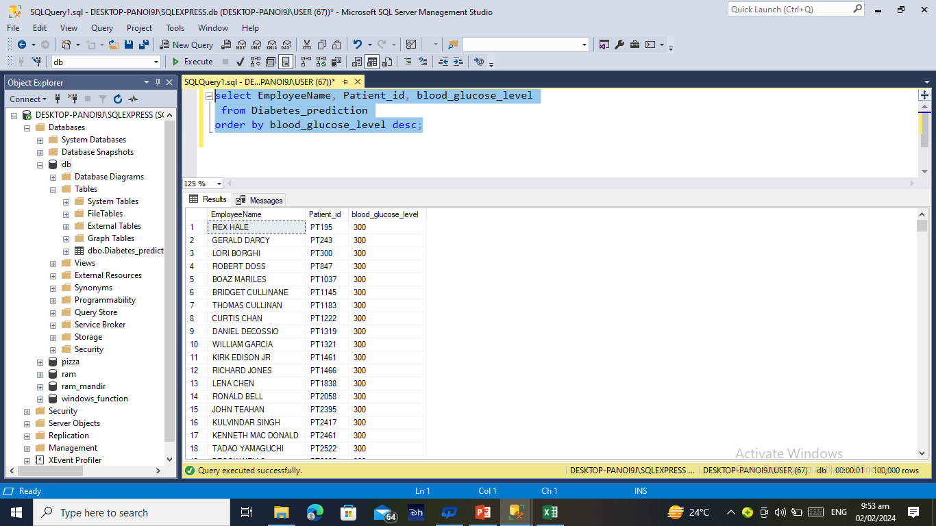
Q4. List patients in descending order of blood glucose levels.

Slide 6
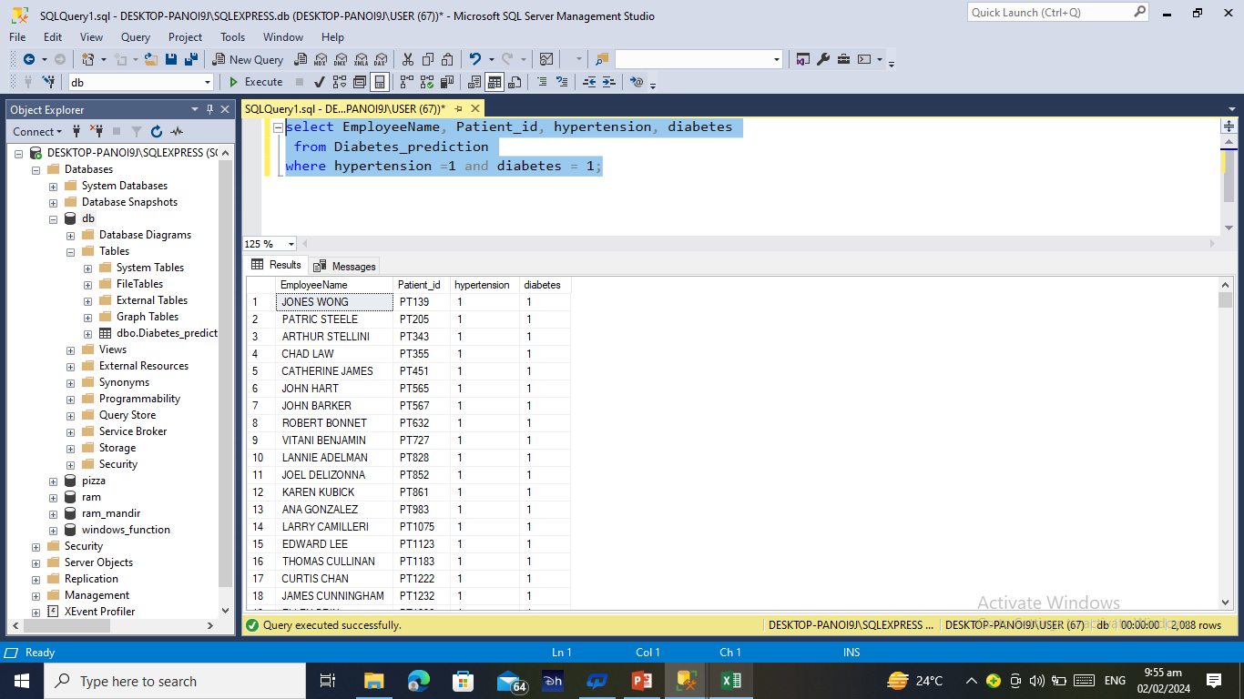
Q5. Find patients who have hypertension and diabetes.

Slide 7
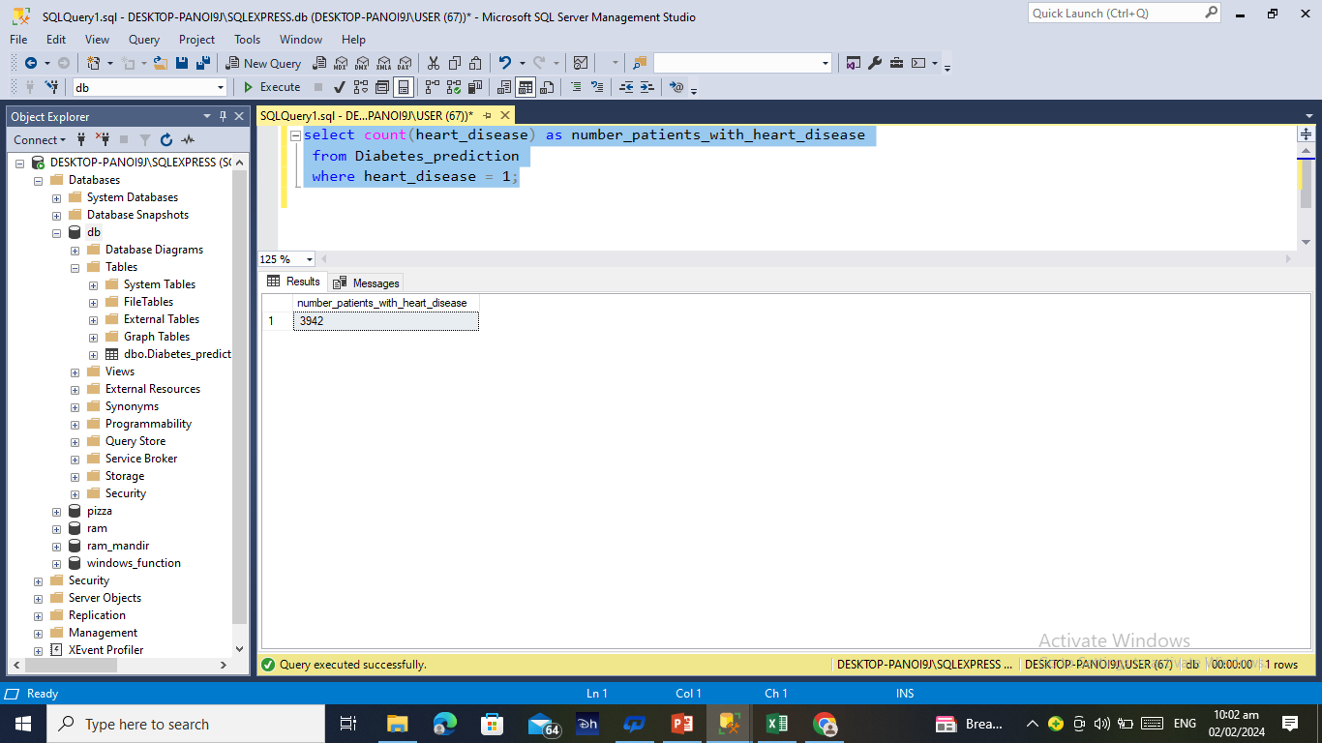
Q6. Determine the number of patients with heart disease

Slide 8
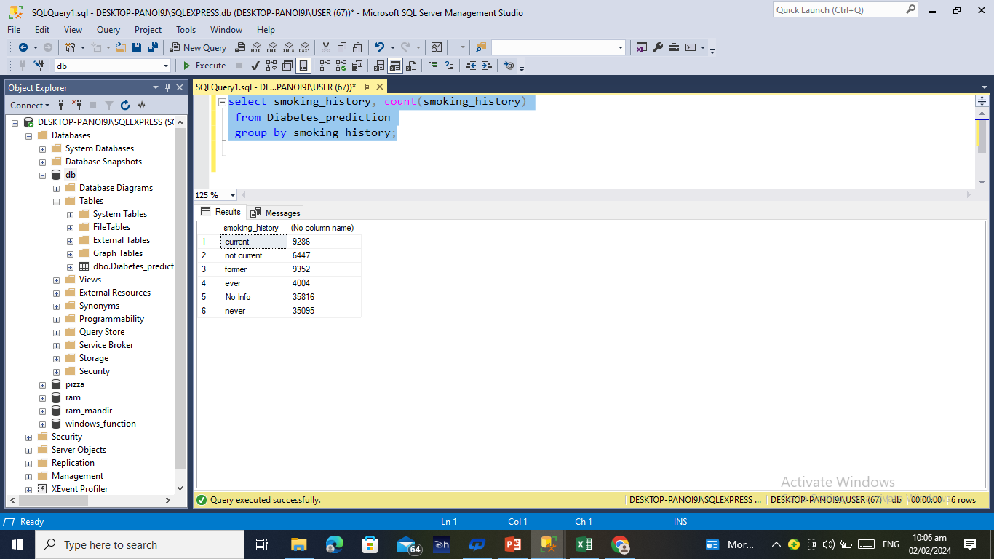
Q7. Group patients by smoking history and count how many smokers and non smokers there are.

Slide 9
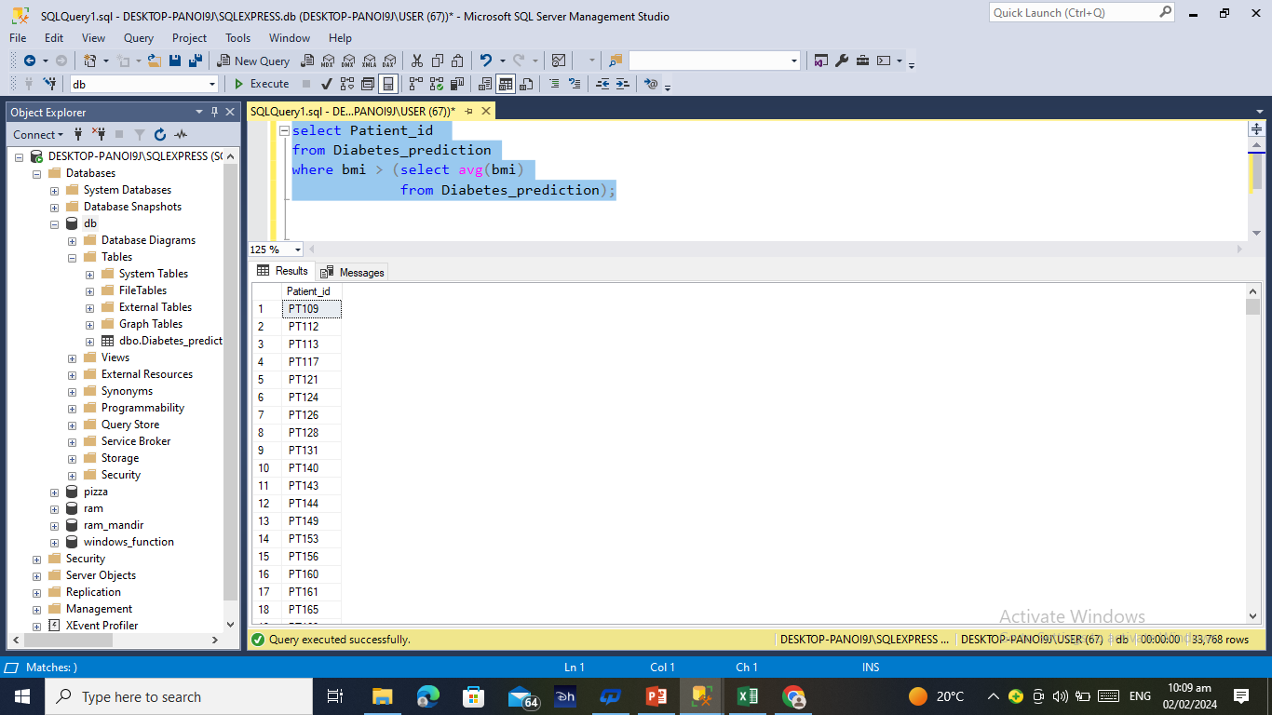
Q8. Retrieve the Patient_ids of patients who have a BMI greater than the average BMI

Slide 10
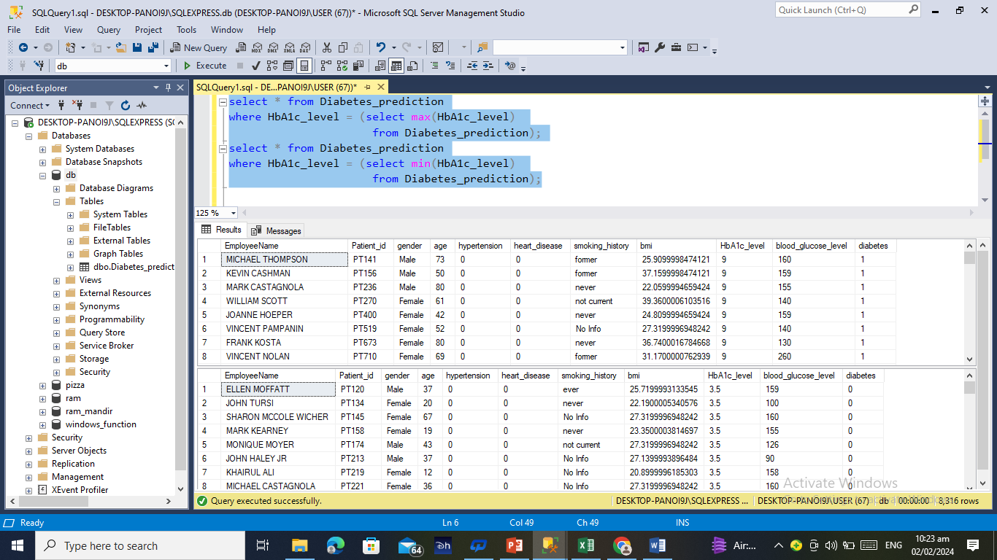
Q9. Find the patient with the highest HbA1c level and the patient with the lowest HbA1clevel.

Slide 11
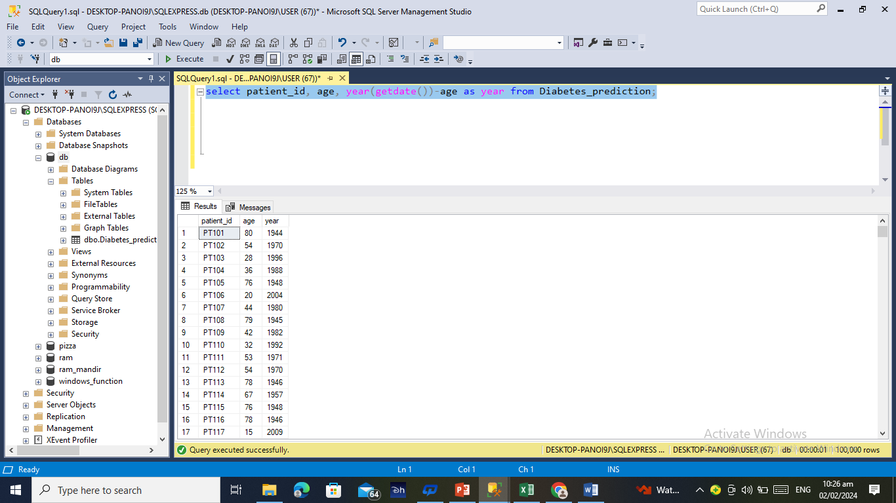
Q10. Calculate the age of patients in years (assuming the current date as of now).

Slide 12
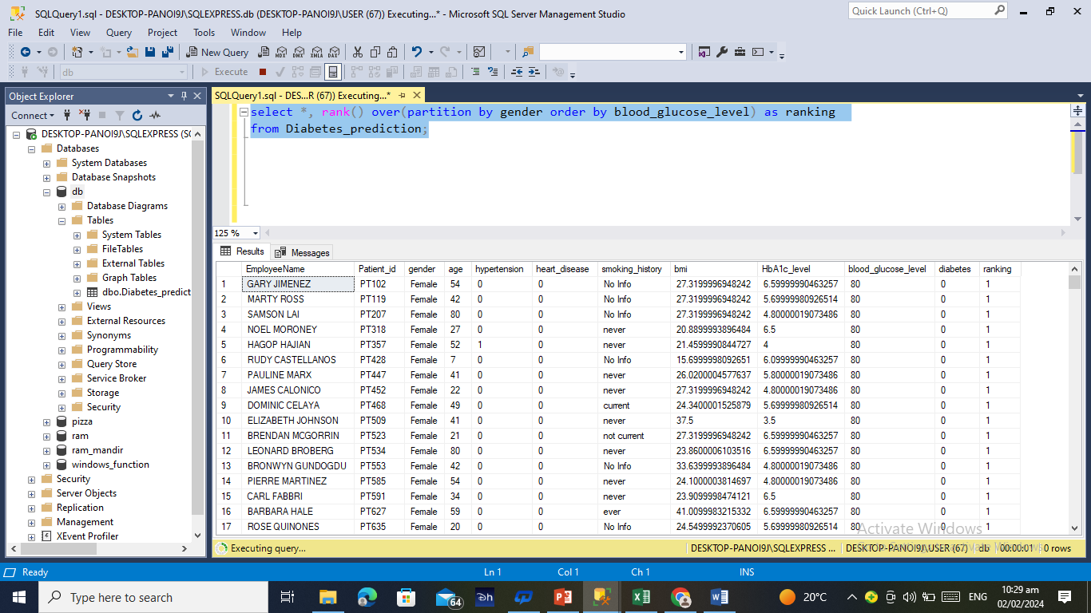
Q11. Rank patients by blood glucose level within each gender group

Slide 13
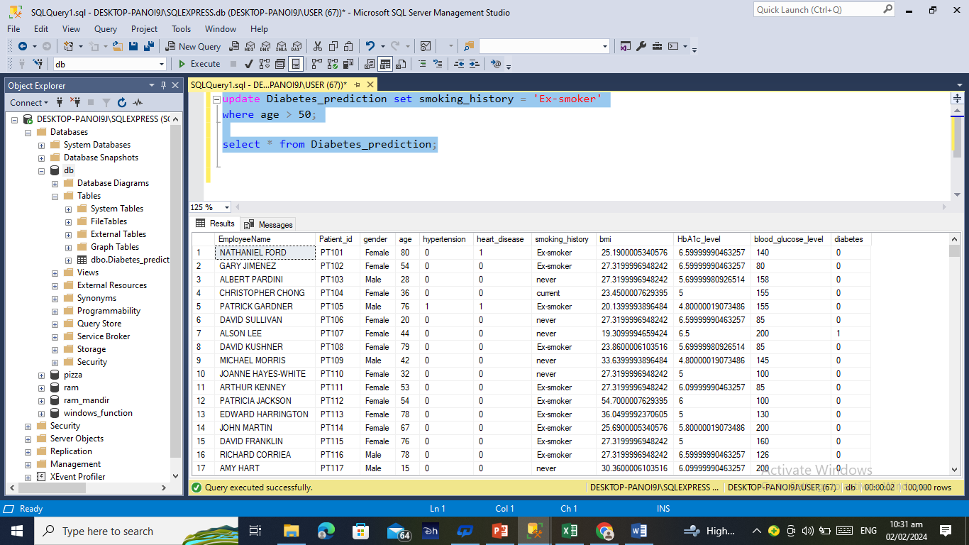
Q12. Update the smoking history of patients who are older than 50 to "Ex-smoker."

Slide 14
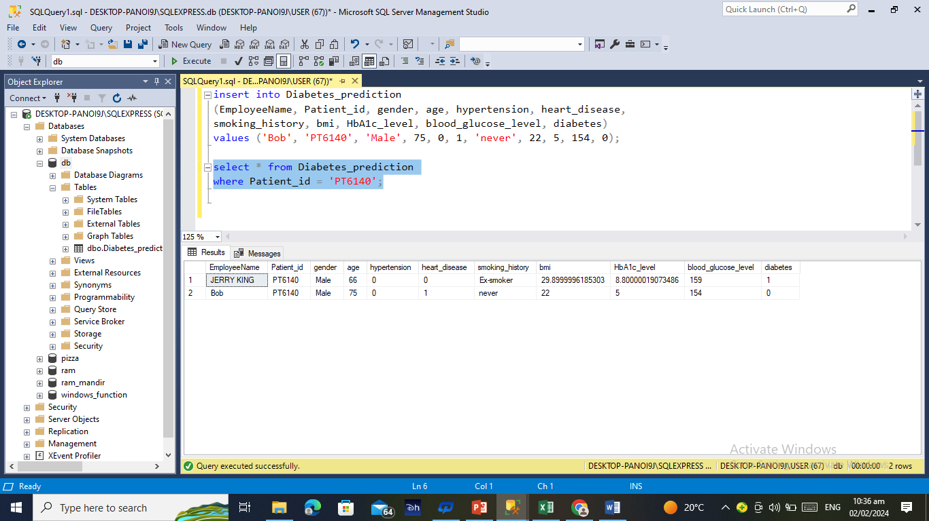
Q13. Insert a new patient into the database with sample data.

Slide 15
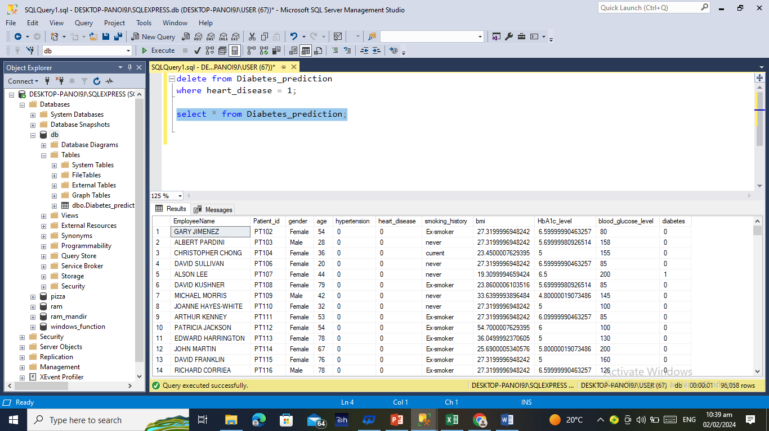
Q14. Delete all patients with heart disease from the database.

Slide 16
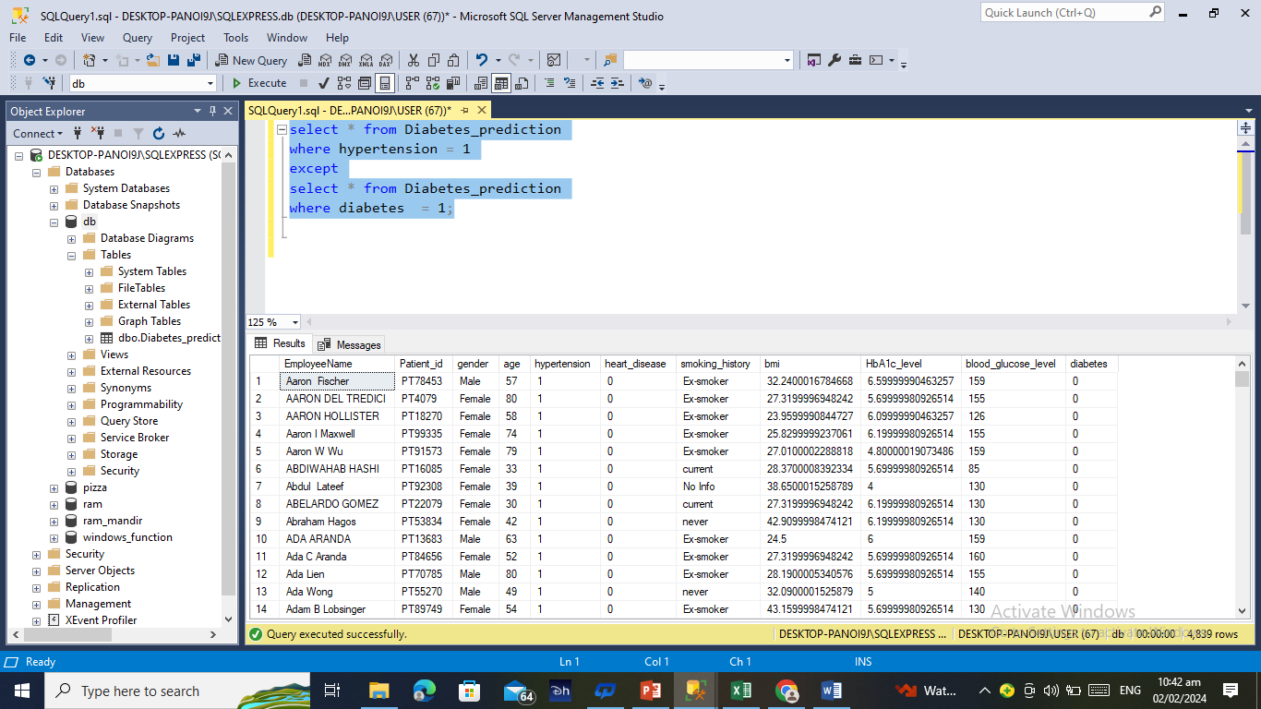
Q15. Find patients who have hypertension but not diabetes using the EXCEPT operator.

Slide 17
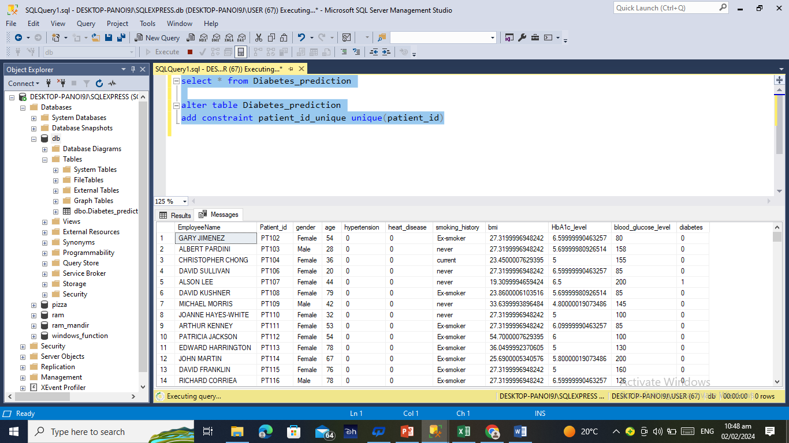
Q16. Define a unique constraint on the "patient_id" column to ensure its values are unique

Slide 18
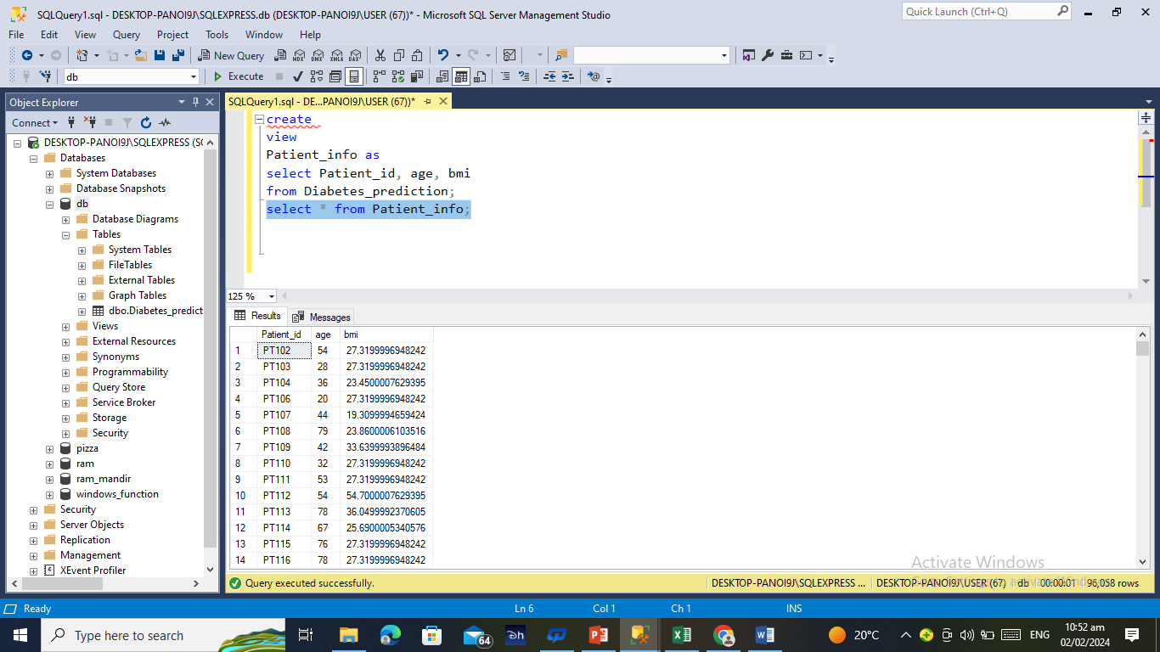
Q17. Create a view that displays the Patient_ids, ages, and BMI of patients.

